Slide 1
Vidya Jyothi Institute of Technology (CSE Department)
Mini Project :
Blackjack with Python
Group Members :
17911A05J4 (A. Aditya)
Internal Project Guide :
M Venkateshwarulu
Project InCharge :
Abdul Majeed

Slide 2

Agenda
Introduction
Famous Casino Game
Existing Systems
Brief explanation
Proposed System
Working
Rules and Gameplay
Drawbacks
Current usage
Advantages
Requirements and modules

Slide 3
Introduction
Blackjack is played in such a way that both the dealer(computer) and player(user )are given two cards each and out of all these cards only a single card of the dealer is visible to everyone.
Based on this, the goal of the player is to determine whether to take another card so that he could he could get a total score that would be greater than that of the dealer but less than 21 and ultimately win the game.

Slide 4
Rules and Gameplay
Hit : Take another card from the dealer.
Stand : Take no more cards also known as “stay”.
The deck is unlimited in size.
As a result, cards are not removed from the deck as they are drawn.
There are no jokers and Jack/Queen/King all count as 10.
The Ace can count as 11 or 1. This is done automatically based on user's hand.
We use the following list as the deck of cards:

Slide 5
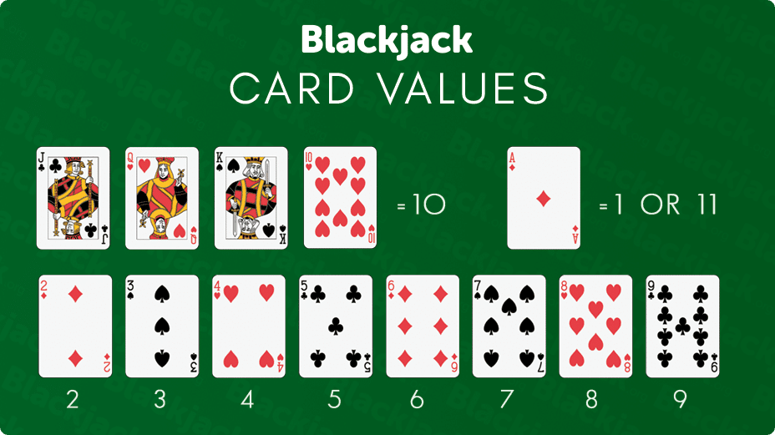

Slide 6
Existing Systems
There are many Blackjack simulation games online, of which, the most popular is the one by Washington Post on their games website.
Disadvantages : But all these simulations are animation based and do not help to curb addiction but instead increase it towards these kind of activities by promoting things like betting by giving fake money from the start and using psychological addiction triggers.
These systems are mainly used for entertainment but may also result in chronic addiction to casino games.

Slide 7
Proposed System
My application is completely text based and as a result, it is not too appealing but also interesting enough to start playing the game.
Advantages : This system does not promote addictive actions but instead encourages logical thinking by prompting the users to make precise calculations and make decisions to win the game ultimately.
It is proven by many research establishments that these kind of watered down casino game experience is effective in treating addiction towards casino games like Blackjack.

Slide 8
Requirements
Software – Any Python IDE, preferably Repl.it
PyCharm for editing the code.
Hardware – This application is designed to run on even the most basic hardware components found on smartphones.

Slide 9
Modules
Card Dealing Module
Player Module
Dealer Module
Game Module
User Interaction Module
Main Display Module

Slide 10
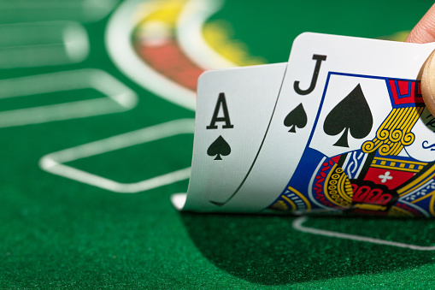
Any Questions?

